Slide 1
In-vehicle Coupon Recommendation

Slide 2
Data set Information
Source:
Kaggle
About Data:
This data was collected via a survey on Amazon Mechanical Turk. The survey describes different driving scenarios including the destination, current time, weather, passenger, etc., and then asks the person whether he will accept the coupon if he is the driver.

Slide 3
Data set Information
Attribute Information:
Nominal:
Destination, Passenger, Weather, Coupon, Marital Status, Education, Occupation, Income, Bar, Coffee House, Restaurant Less than 20, Time, Restaurant 20 to 50
Binary :
Gender, Has Children, To Coupon 5 mins, To Coupon 15min, To Coupon 25 mins, Direction Same, Direction Opp.
Numerical:
Temperature, Expiration, Age.

Slide 4
Target Variable:
Binary - Whether the coupon is accepted or not (Yes/No or 1 / 0)
Reason: We want to predict based on multiple scenarios, if a coupon is offered at a drive thru, will that person accept it or not. Here, the variables are a mix of nominal and binary.

Slide 5
Dataset Modifications:
The original dataset has more than 12,600 rows and 26 columns. We Removed one column and rows which are empty data. We were left with 12000 rows, out of which we randomly selected 5000 rows. We used Pandas in python to do the data processing.

Slide 6
Data Set Exploration:
The data set is partitioned into 80 percent training data, 10 percent validation data and remaining 10 percent testing data. Most of the data is assigned into training to get the better model.
Later, a filter node is been used to filter out the outliers present in the dataset that affects the model.

Slide 7
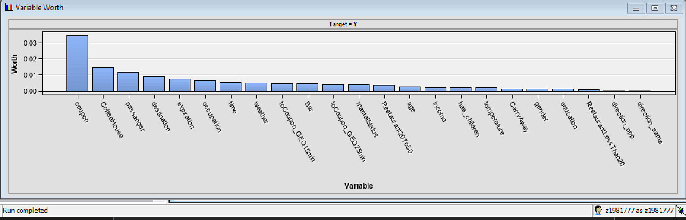
Variable Worth:

Slide 8
Variable Worth:
The 'Coupon' variable has the highest correlation with the target variable.
Followed by, 'CoffeeHouse', 'Passanger', 'Destinatation' and etc.

Slide 9
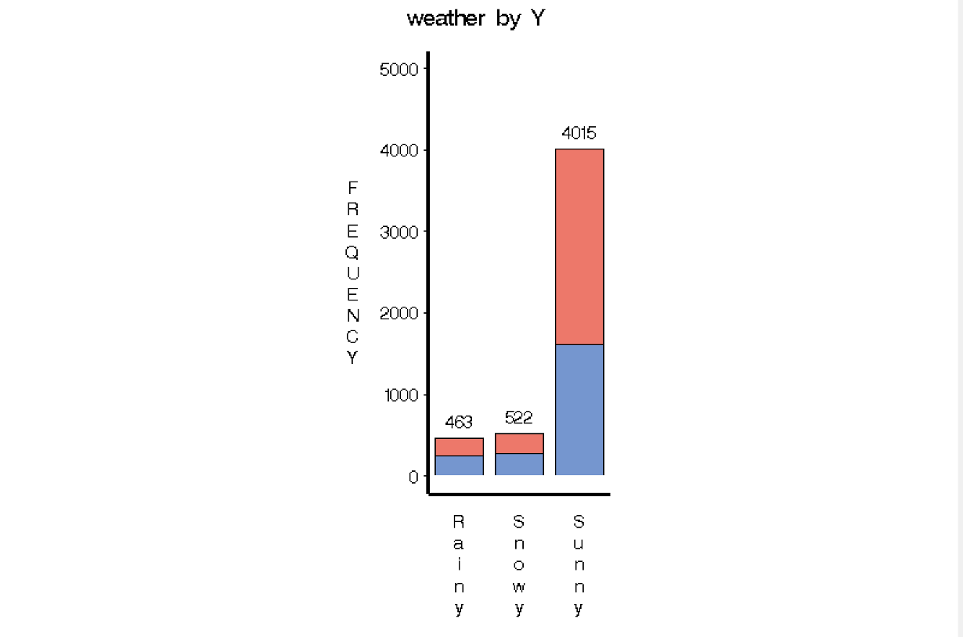

Slide 10
Targeted variable plotting:
If the weather is sunny, there is a high probability that the person will accept the coupon.

Slide 11
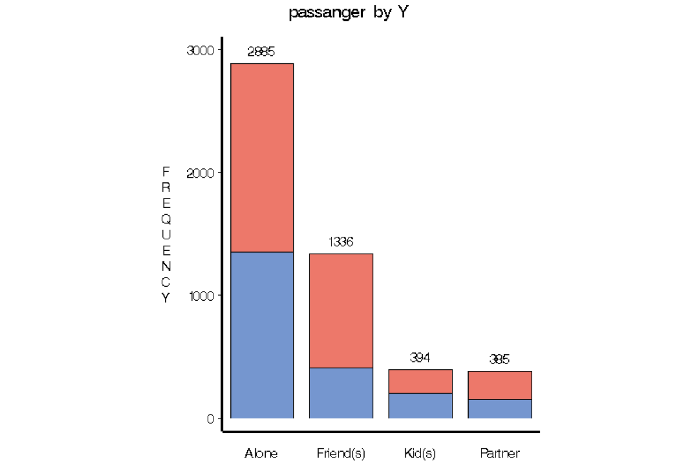

Slide 12
Targeted variable plotting:
If a driver has a friend in the passenger seat, then there is a high probability that the person will accept the coupon.

Slide 13
From the data exploration it is observed that, variables like ‘RestaurantLessThan20’, ‘direction_opp’, ‘direction_same’, and ‘education’ are less impactful in predicting the target variable.
Using Drop node, these less impactful variables were dropped from the model.
Also, Transformation node is used to do variable transformation to make the model fit better.

Slide 14
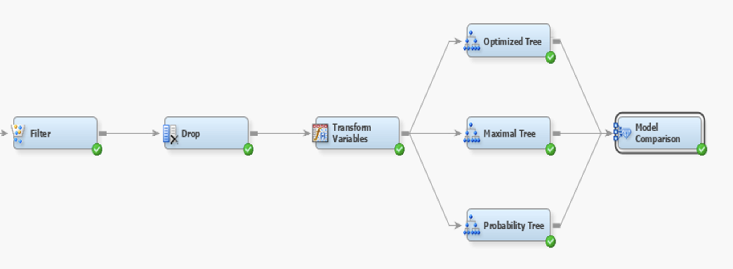
A model comparison node is used to select the best model out of 'Optimal Tree', 'Maximal Tree' and 'Probability Tree'

Slide 15
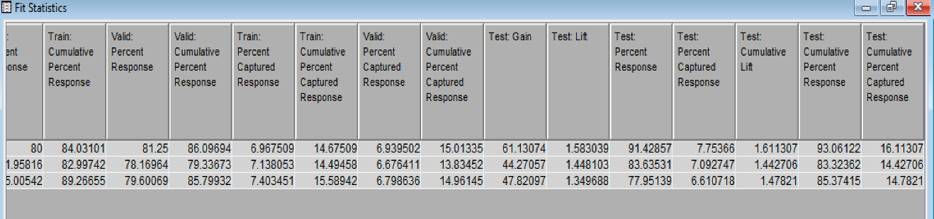
From the comparison, we have found out that the probability tree has the highest cumulative percent captured response. We can conclude that Probability tree is the better model.

Slide 16
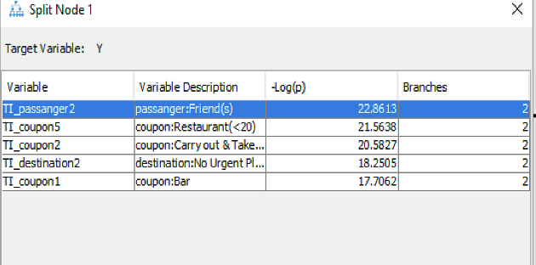
Important Variables as per Probability Tree
TI_passanger2 – Passenger: Friends
TI_coupon5 – Restaurant (<20)
TI_coupon2 – Carry out & Take Away
TI_destinatation2 – destination: No urgent place
TI_coupon1 – coupon: Bar

Slide 17
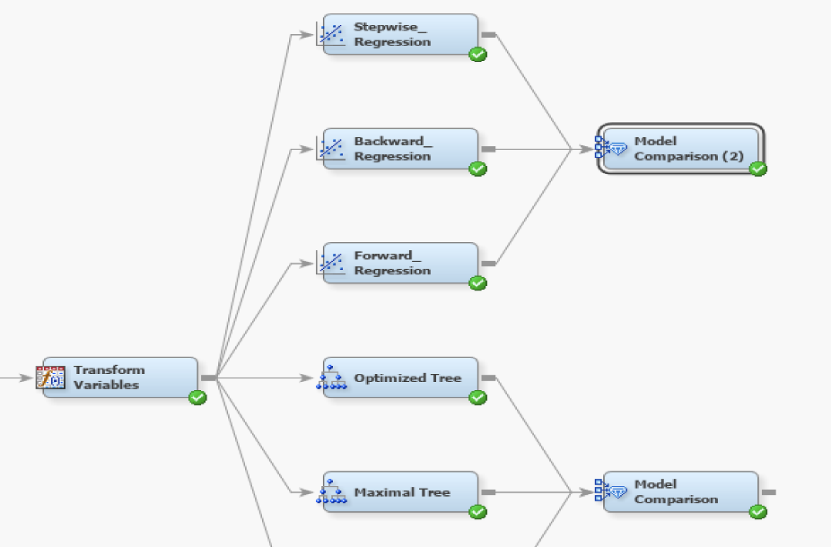
Later, we have done comparison between stepwise regression, backward regression and forward regression of Logistic regression using model comparison.

Slide 18
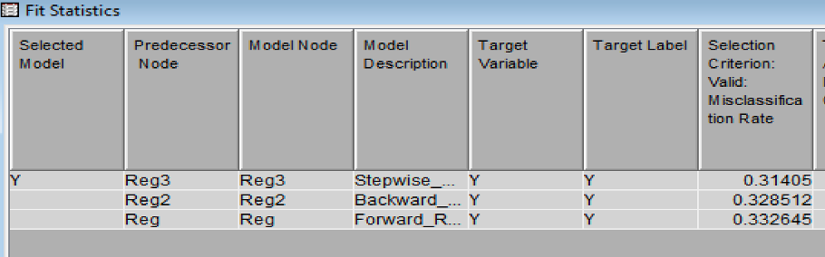
As per the misclassification rate error, we have found out that stepwise regression is the best regression model.

Slide 19
Best variables:
TI_Bar3 TI_CoffeeHouse1 TI_CoffeeHouse2 TI_coupon1 TI_coupon2 TI_coupon5 TI_destination2 TI_expiration1 TI_gender1 TI_income3 TI_income5 TI_income9 TI_maritalStatus3 TI_occupation10 TI_occupation18 TI_occupation6 TI_occupation9 TI_passanger2 TI_passanger3 TI_time4 TI_toCoupon_GEQ15min1 TI_weather3

Slide 20
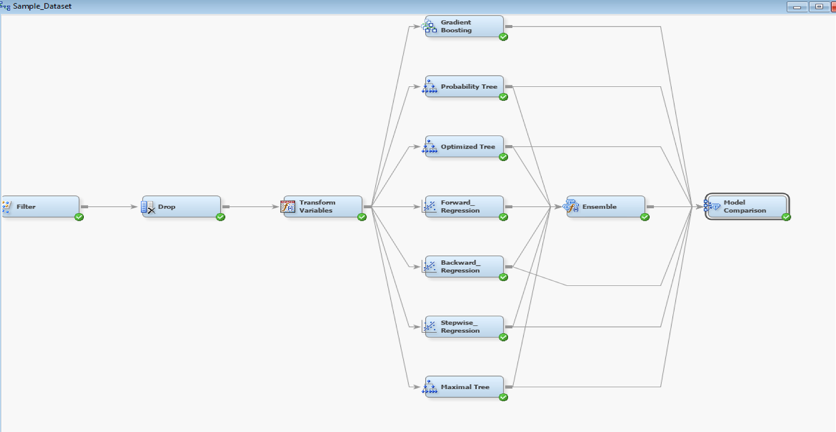
Comparing all the models along with gradient boosting and Ensemble model.

Slide 21
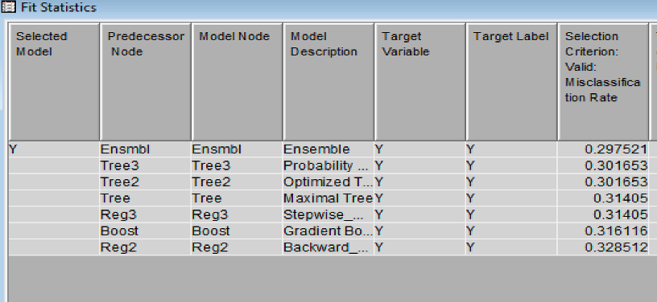
From the end results, we conclude that "Ensemble model" yields the best results in comparison with the other models as per the validation misclassification rate

Slide 22
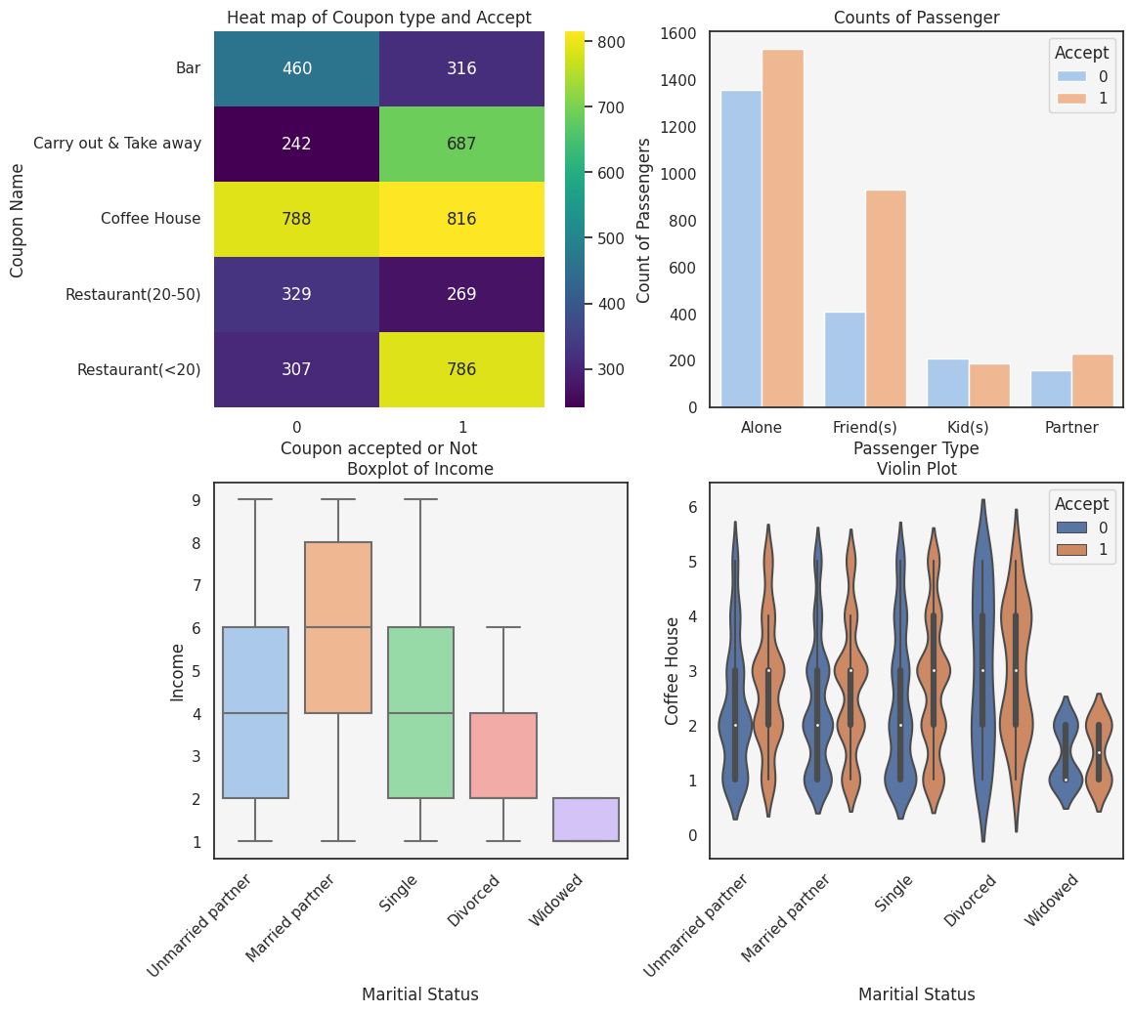

Slide 23
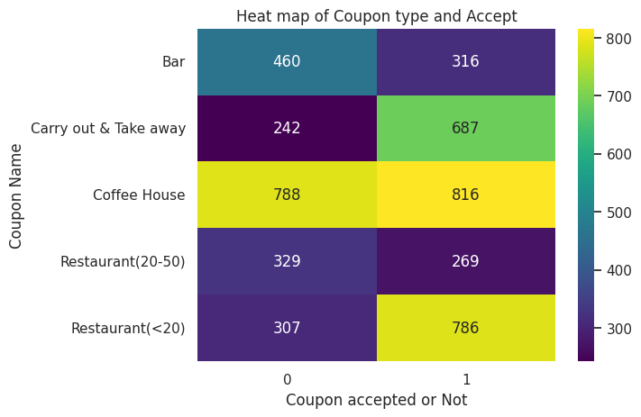

Slide 24
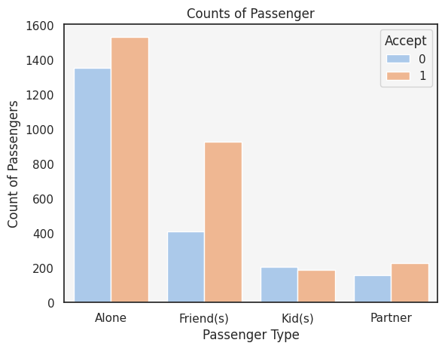

Slide 25
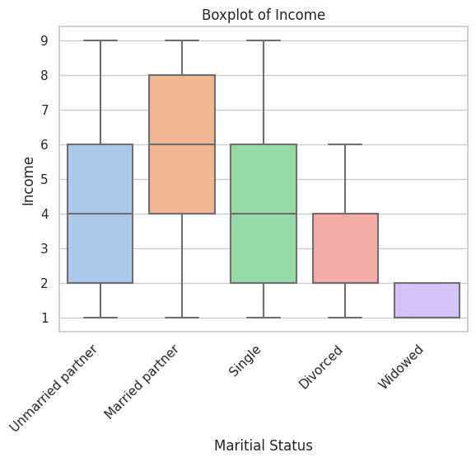

Slide 26
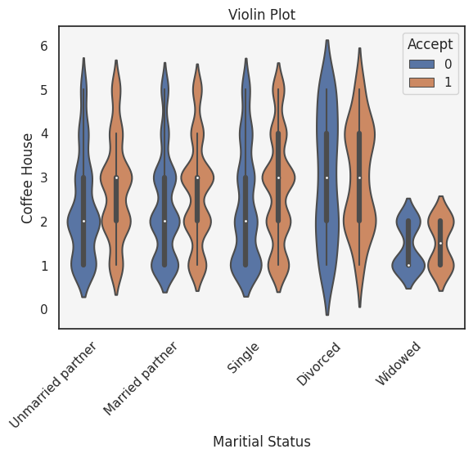

Slide 27

Team Members Durgaprasad Koppala Z1981777
Sri Sai Sathya Keshav Arigela Z1982756
Sree Harshita Reddy Gangasani Z1978262
Nikhil Vishnu Teja Madasu Z1980332
Dileep Durgam Z1983282
Jyothi Naga Lakshmi Addala Z1980359

